Slide 1
Commercial Prototype Production

Slide 2
Engineering Goals
Fit into standard multiwell plate cutout in stage
Be thin and mostly exist below grade
All slide mounting and priming is done outside of chamber and slide complex is placed into chamber for imaging.
Slide complex goal is to be only marginally larger than slide itself
Regularize fluidic device production
Fuse fluidic device and pressure plate into one item
Easy fluidic connection for users, ie quick connect.
Add in corner screws for leveling
Decently aesthetic design
Make modular
Temp reg
Multislides
3D domes

Slide 3
Device forming and Priming
The first task is split into two areas
Can we use a form for the fluidic device uppers?
Can it be primed by hand while sealed?
Its is unknown if an SLA printed upper form to make more complex shapes would be possible. Lets make some sample ones and trial it.
Rough goals of form:
1mm thick around window
Need window block
Thicken height in port region
Make edges more exact

Slide 4
Maybe ss 17-4 ph from protolabs

Slide 5

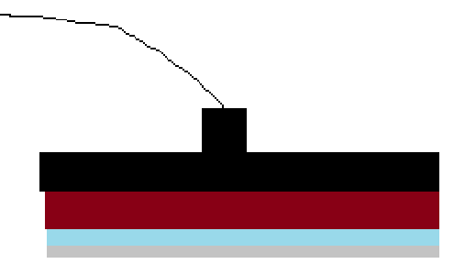
Heart of Device: The Fluidic Sandwich
To balance engineering complexity and user ease, we have opted to create a fluidic sandwich exterior to the chamber which can then be placed into chamber on stage
Constraints
No complex joints like slides, hinges, spring assemblies (can be complete units though).
Width of slide, but can be longer than slide
As thin as possible
Fluidic connections baked into pressure plate + fludic device combo
Fluidic device and pressure plate are integrated together, but able to be separated if needed
‘fool proof’ jig placements
All parts able to be CNCed
Freedom to choose along long slide axis for device placement
Pressure Plate
Fluidic Device
Where magnets are
Slide
Stainless Steel

Slide 6
Key Changes from Current Model
By placing magnets only on ends, it enabled the width to be that of the slide or just slightly larger
To make a compact moveable sandwich, the bottom has to be a plate. Currently we have embedded magnets encased in resin. This leads to 2 issues. Thicker and need exact placement. Going to SS, the specificity goes away, its simpler and thinner
Fluidic device and PP are integrated and integrated with fluidics

Slide 7
Key Risks
Can magnets on just the ends give enough force to seal?
The reduced B field from mags being over the slide and not off to the side and from SS instead of another mag. Will it be enough to seal?

Slide 8
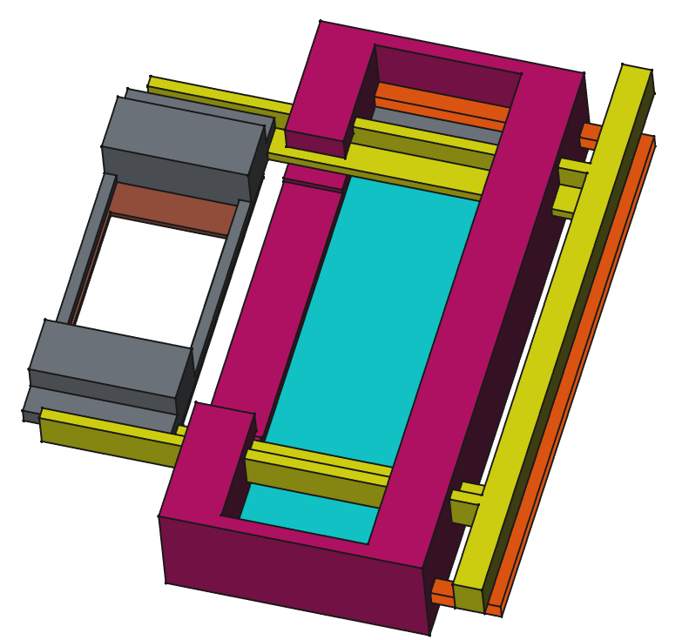
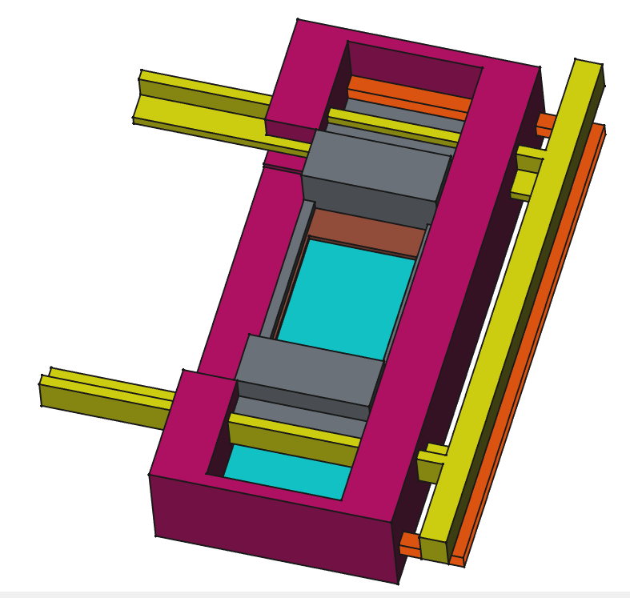
Cassette style insert
1. Insert both yellow rail guide and the orange brace to hold the stainless steel plate in place and then start the pressure plate complex on the rails
2. Shift the pressure plate complex all the way to the end

Slide 9
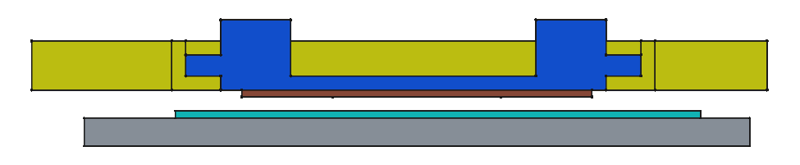
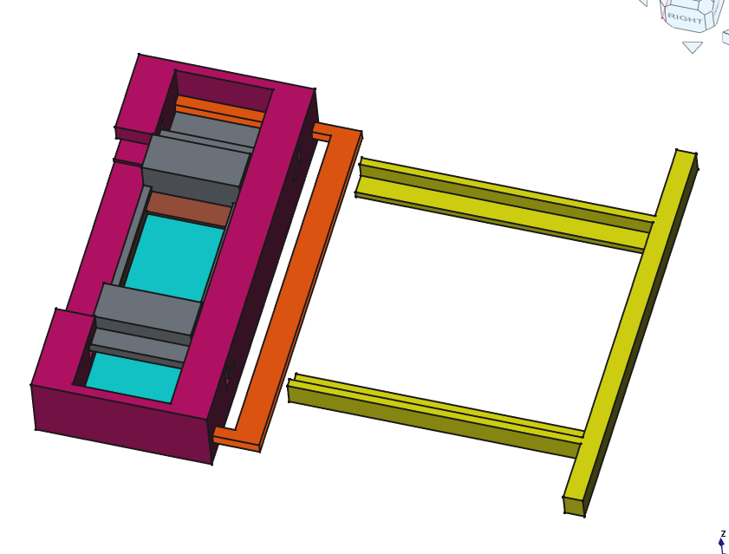
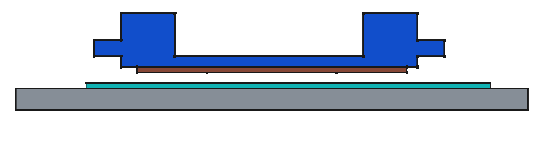
3. (front view) start fluid flow (not shown)
4. While flowing, pull yellow guide rail track out
5. (front view) pressure plate complex and slide will seal together

Slide 10
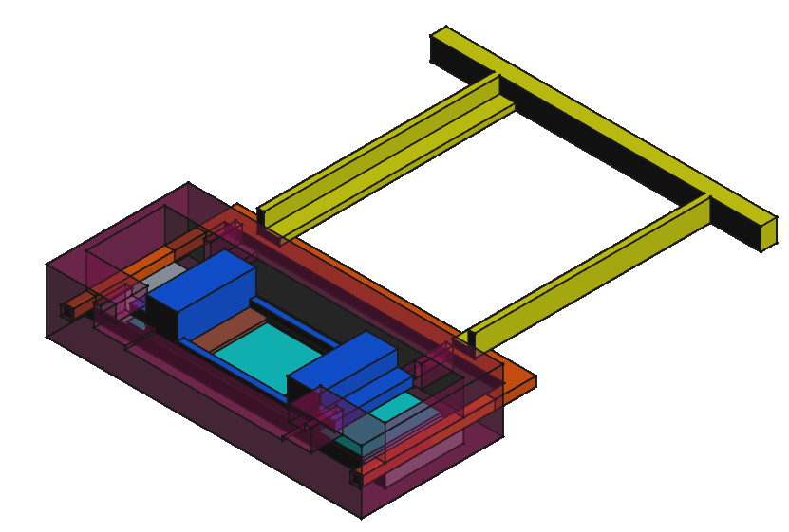
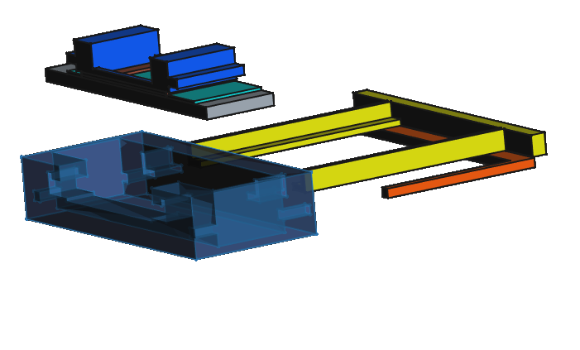
5. Same as previous step, but angled perspective view
6. Pull out orange device and pull up on sandwich complex to remove from jig

Slide 11
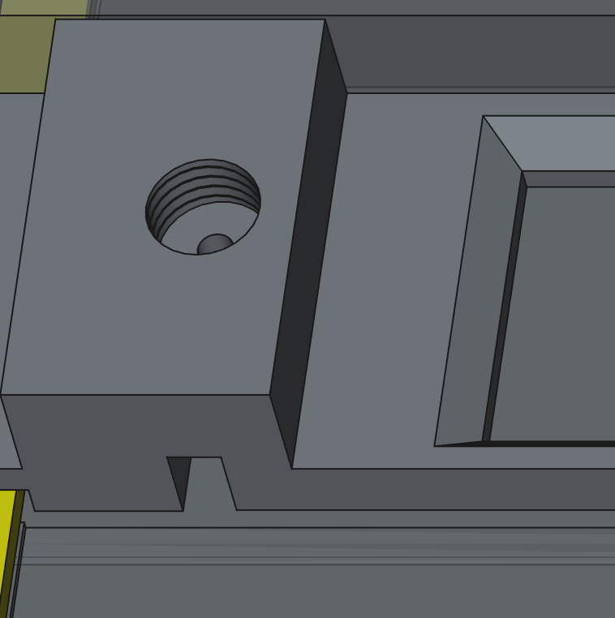
Threads
Microfludic connectors are ¼ inch-28 connectors. This is 1/4inch, fine UNF threads (28 threads per inch)

Slide 12
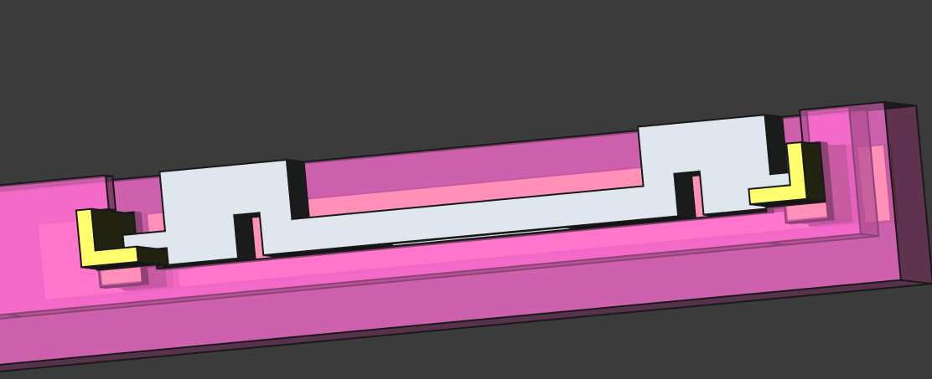
Unified Slide Design
Merged the two slides into one. This contains both the rail slides and a built-in spacer to pin the slide/SS plate down and maintain a gap between the fluidic device and slide.

